Slide 1
Human rights, conflict resolution, and alternative dispute resolution (adr)
Alexandru Balas, PhD

Slide 2
Human Rights
Political Rights
Right to vote
Freedom of association
Right to assemble
Right to a fair trail
Civil Rights
Protection from discrimination based on gender, religion, race, nationality, age, sexual orientation
Freedom of speech, thought, religion, press, and movement
Economic, Social, and Cultural Rights
Right to work
Right to education
Right to housing
Right to health

Slide 3
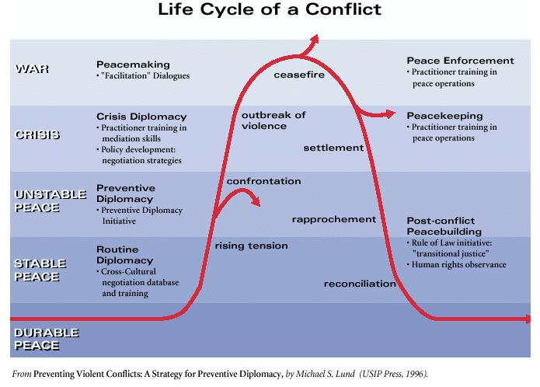

Slide 4
Conflict Resolution Phases
I refer to conflict resolution as the “catch-all” concept that encompasses all the 3rd party interventions at different stages of the conflict.
Conflict Prevention
Conflict Management
Peacebuilding (conflict resolution)
Conflict Transformation

Slide 5
Alternative Dispute Resolution (ADR)
Mediation
Conciliation
Arbitration
Activities mainly found at the conflict management & conflict resolution levels of 3rd party involvement.
ONLINE DISPUTE RESOLUTION (ODR)

Slide 6
Human Rights and Conflict Resolution
Operate in the same environments
Similar goal: help create stable and just peace
Rarely work together
WHY?
Different perspectives on conflicts
Different assumptions
Different methodologies
Different goals
Scholars & Practitioners have not paid much attention to the links between the two fields

Slide 7
Human Rights and CR Differences
 | CONFLICT RESOLUTION PRACTITIONERS | HUMAN RIGHTS ADVOCATES
DIFFERENT ASSUMPTIONS | 1ST PEACE No justice without peace | 1ST JUSTICE No peace without justice
DIFFERENT METHODOLOGIES | Persuasion Conciliatory Pragmatic | Coercion Aggressive Principled
DIFFERENT GOALS | Negative peace Stop the violence Reconcile needs & interests | Positive peace Dispense justice Punish the guilty Transform the structures of discrimination

Slide 8
What do they think of each other?
PERCEPTIONS ABOUT CONFLICT RESOLUTION PRACTITIONERS | PERCEPTIONS ABOUT HUMAN RIGHTS ADVOCATES
Non-adversarial Value-neutral | Adversarial Judgmental
Everything is negotiable | Outcome-directed, no concern for process Conversation-stoppers
All individuals are redeemable | Believers in the power of shame
Peace comes above everything | Justice comes above everything
 | Absolutist
 | Unwilling to consider non-HR issues
 | CONFLICT PARTIES

Slide 9
Human Rights and Conflict Prevention
Human Rights as the CAUSE of conflict
Request for respecting human rights can become violent
Systematic Human Rights violations can lead to conflict
Human Rights requests or violations – INDICATORS of rising tension for conflict prevention practitioners
Similarities: address problems before they erupt and spread
Tensions:
Public Blaming vs. Conciliatory-”Let’s work together”
The problem is “them” vs. This is the problem-how do we all solve it?
Change structures of discrimination vs. maintain structures of discrimination

Slide 10
Human Rights and Conflict Management
Human rights field operations attached to peacekeeping missions (e.g.: UNTAG-Namibia; ONUSAL El Salvador)
UNTAG – field jurist with responsibility for political prisoners and detainees
ONUSAL – human rights provisions saved the peace process
El Salvador, HR monitors built confidence between the parties and in the 3rd party (UN)
HR monitors can act as fact-finders for the mediators
HR monitors can assess the needs for peacebuilding- this information can be used as an incentive by mediators
El Salvador, short-term ceasefire required a long-term solution for dealing with HR violations
HR as bargaining chip (e.g.: North. Ireland) – when peace process is blocked (decommissioning)

Slide 11
Human Rights – Symptoms of Conflict
If human rights violations are symptoms of conflict, stopping the violence stops the HR violations
SIMILARITIES: Conflict management practitioners and HR activists share the goal to stop the violence
ACTIVITIES:
peacekeeping
peace-enforcement
humanitarian intervention
humanitarian relief assistance
human rights monitoring
negotiating cease-fires
settlement of displaced persons

Slide 12
Human Rights – Causes of Conflict
If human rights violations are causes of conflict, mitigating the violence does not stop the HR violations
TENSIONS: Conflict management and HR have different goals.
HR ACTIVITIES: reduce structural violence
Conflict management ACTIVITIES: Mitigate the violence first (negative peace), deal with the conflict causes and human rights violations later
ISSUES
Negative Peace vs. Justice
Negotiation Table

Slide 13
Next Sessions
Session 2 – Challenges between ADR and HR
Session 3 – Synergies between ADR and HR
Session 4 – ADR in Indigenous and Civil Rights Violations
Session 5 – ADR in Business Human Rights violations
Session 6 – Online Dispute Resolution

